Slide 1
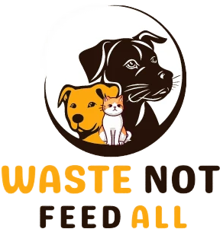
Waste Not, Feed All
GROUP MEMBERS:
Waleed Ghani (15904)
Areeba Waheed (15853)
Kamna Bai (15834)
Alisha Meraj (15854)
Laiba Malik (16899)
Sidra tul Muntaha (16761)
Muhammad Asharib khan(16673)

Slide 2

Waste Not, Feed All
Waste Not, Feed All aims to reduce food waste and feed stray animals by connecting restaurants with animal shelters and individuals who can provide food for strays.

Slide 3

Develop Project Idea
The project idea is to create a platform that connects restaurants with animal shelters and individuals who can provide food for stray animals. This would help reduce food waste and ensure that stray animals have access to nutritious food.
1
Restaurant Waste
2
Animal Shelters
3
Stray Animals
Restaurants often have a significant amount of leftover food that they discard.
Animal shelters need to provide food for the animals in their care, and they can sometimes struggle to meet their needs.
Stray animals often lack access to regular food sources, and they can face health issues as a result.

Slide 4
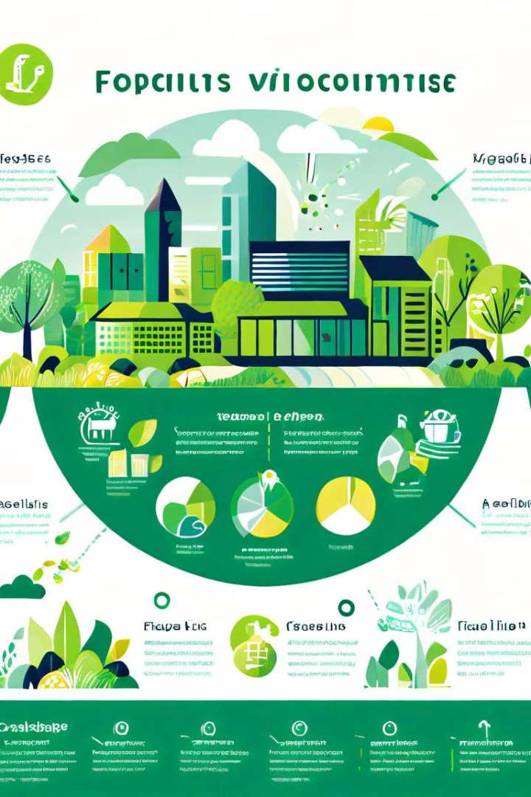
Set Goals and Measures
The project aims to reduce food waste by 50% in the target area. The project also aims to increase the number of stray animals fed by 20% within the first year of implementation.
1
Phase 1: Awareness
Educate restaurants and community members about food waste and the benefits of feeding stray animals.
2
Phase 2: Connection
Connect restaurants with animal shelters and individuals who can provide food for stray animals.
3
Phase 3: Sustainability
Develop a system to ensure the long-term sustainability of the project through partnerships and fundraising.

Slide 5
Research
Research is crucial for understanding the current situation of food waste and stray animals in the target area.
Food Waste
Animal Shelters
Stray Animals
Identify the types of food waste generated by restaurants and the challenges in redistributing it.
Identify local shelters and their needs, including the number of animals they care for and their food requirements.
Assess the number of stray animals in the area and their access to food sources.

Slide 6
Food Waste:
Shocking Figures and Impacts

Slide 7
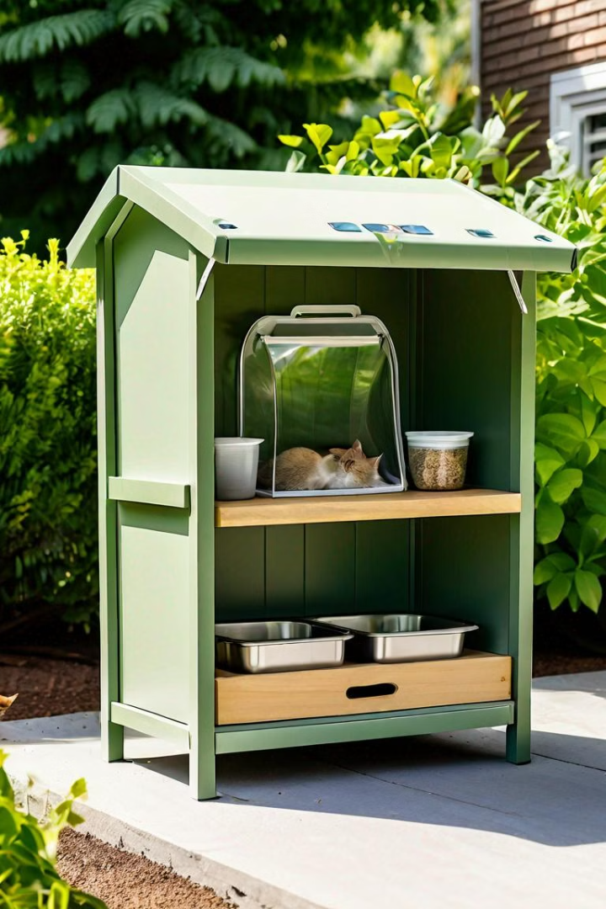
Feeding Stations
Feeding stations are designated locations where individuals can drop off leftover food from home, ensuring its safe and accessible for animals.
Food Safety
Accessible Locations
Food donated must be safe for consumption, with a focus on hygiene and freshness. Ensure all food is properly stored in a secure container, protecting it from rain, rodents, and contamination.
Locate feeding stations in strategic areas where stray animals congregate, ensuring accessibility and ease of access. Consider locations with natural shade or sheltered spaces for protection from the elements.
Community Involvement
Encourage community members to monitor the feeding stations, ensuring food is replenished regularly and the area is kept clean. Fostering community ownership helps create a sustainable program.

Slide 8

Align with SDGs
The project aligns with several Sustainable Development Goals (SDGs), including reducing food waste and hunger, improving animal welfare, and promoting sustainable communities.
SDG 2
End hunger, achieve food security and improved nutrition and promote sustainable agriculture
SDG 12
Ensure sustainable consumption and production patterns
SDG 15
Protect, restore and promote sustainable use of terrestrial ecosystems, sustainably manage forests, combat desertification, and halt and reverse land degradation and halt biodiversity loss

Slide 9




Delegate Tasks
The project requires a team of individuals with different skills and expertise to ensure its successful implementation
Partnership Building
Establish partnerships with restaurants, animal shelters, and other organizations to create a network of support.
Volunteer Recruitment
Recruit volunteers to assist with food collection, distribution, and other tasks.
Community Outreach
Promote the project to the community to raise awareness and encourage participation.

Slide 10





Conclusion
No Waste, Feed All has the potential to make a significant impact by reducing food waste and providing food for stray animals.
Food Security
Animal Welfare
The project helps ensure that both humans and animals have access to nutritious food.
The project improves the health and well-being of stray animals by providing them with a consistent food source.
Sustainability
Community Engagement
The project promotes sustainable practices by reducing food waste and promoting responsible consumption.
The project brings together individuals and organizations to address a common challenge.

